Slide 1
Evaluation of Learning Models
Lecture by Shangsong Liang
Sun Yat-sen University
Thanks to Evgueni Smirnov

Slide 2
How to check if a model fit is good?
The R² statistic has become the almost universally standard measure for model fit in linear models.
What is R²?
It is the ratio of error in a model over the total variance in the dependent variable.
Hence the lower the error, the higher the R2 value.

Slide 3
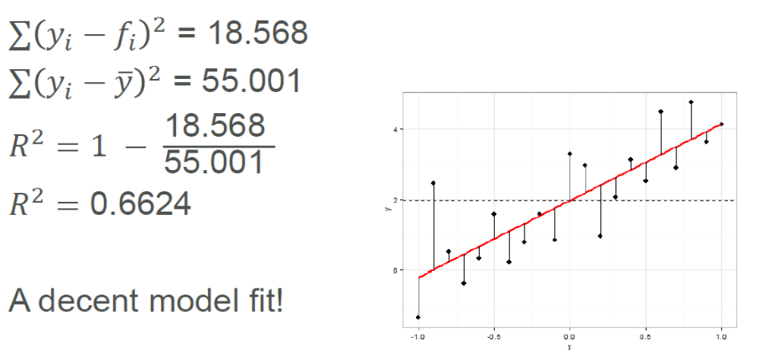
How to check if a model fit is good?

Slide 4
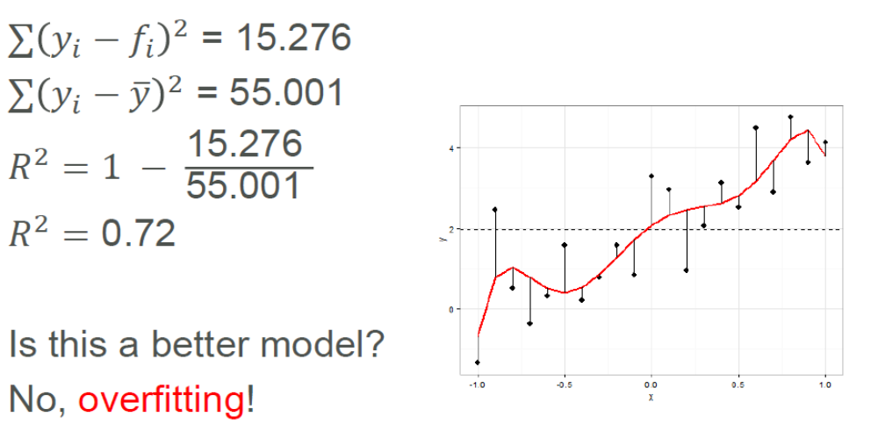
How to check if a model fit is good?

Slide 5
OVERFITTING
Modeling techniques tend to overfit the data.
Multiple regression:
Every time you add a variable to the regression, the model’s R² goes up.
Naïve interpretation: every additional predictive variable helps to explain yet more of the target’s variance. But that can’t be true!
Left to its own devices, Multiple Regression will fit too many patterns.
A reason why modeling requires subject-matter expertise.

Slide 6
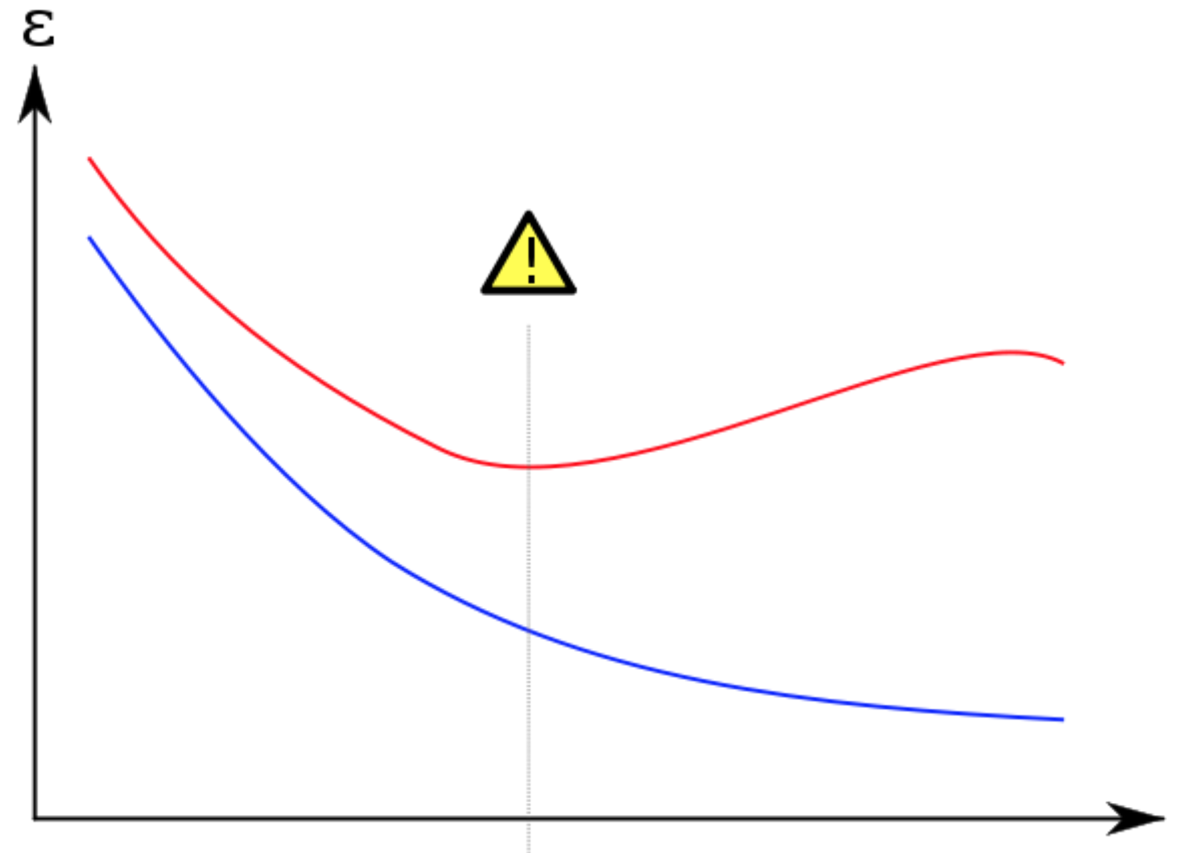
OVERFITTING
Error on the dataset used to fit the model can be misleading
› Doesn’t predict future performance.
Too much complexity can diminish model’s accuracy on future data.
› Sometimes called the Bias-Variance Tradeoff.

Slide 7
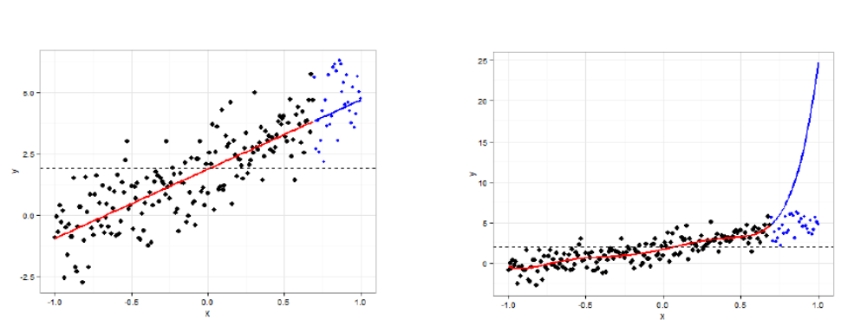
OVERFITTING
What are the consequences of overfitting?
›“Overfitted models will have high R² values, but will perform poorly in predicting out-of-sample cases”

Slide 8
Estimation with Training Data
The accuracy/error estimates on the training data are not good indicators of performance on future data.
  Q: Why?
  A: Because new data will probably not be exactly the same as the training data!
The accuracy/error estimates on the training data measure the degree of classifier’s overfitting.
Classifier
Training set
Training set

Slide 9
Estimation with Independent Test Data
Estimation with independent test data is used when we have plenty of data and there is a natural way to forming training and test data.
For example: Quinlan in 1987 reported experiments in a medical domain for which the classifiers were trained on data from 1985 and tested on data from 1986.
Classifier
Training set
Test set

Slide 10
Hold-out Method (留出法)
The hold-out method splits the data into training data and test data (usually 2/3 for train, 1/3 for test). Then we build a classifier using the train data and test it using the test data.
The hold-out method is usually used when we have thousands of instances, including several hundred instances from each class.
Classifier
Training set
Test set
Data

Slide 11
Classification: Train, Validation, Test Split
Results Known
+
Model
Builder
+
Training set
-
-
Data
+
Evaluate
Classifier Builder
Predictions
+
-
+
-
Y
N
Validation set
+
-
+
-
Final Evaluation
Final Test Set
Classifier
The test data can’t be used for parameter tuning!

Slide 12
Making the Most of the Data
Once evaluation is complete, all the data can be used to build the final classifier.
Generally, the larger the training data the better the classifier (but returns diminish).
The larger the test data the more accurate the error estimate.

Slide 13
Stratification
The holdout method (留出法) reserves a certain amount for testing and uses the remainder for training.
  Usually: one third for testing, the rest for training.
For “unbalanced” datasets, samples might not be representative.
  Few or none instances of some classes.
Stratified (分层) sample: advanced version of balancing the data.
  Make sure that each class is represented with approximately equal proportions in both subsets.

Slide 14
Repeated Holdout Method
Holdout estimate can be made more reliable by repeating the process with different subsamples.
  In each iteration, a certain proportion is randomly selected for training (possibly with stratification).
  The error rates on the different iterations are averaged to yield an overall error rate.
This is called the repeated holdout method.

Slide 15
Repeated Holdout Method
Still not optimum: the different test sets overlap, but we would like all our instances from the data to be tested at least ones.
Can we prevent overlapping?

Slide 16
k-Fold Cross-Validation
k-fold cross-validation avoids overlapping test sets:
  First step: data is split into k subsets of equal size;
  Second step: each subset in turn is used for testing and the remainder for training.
The subsets are stratified
before the cross-validation.
The estimates are averaged to
yield an overall estimate.
Classifier
train
train
test
Data
train
test
train
test
train
train

Slide 17
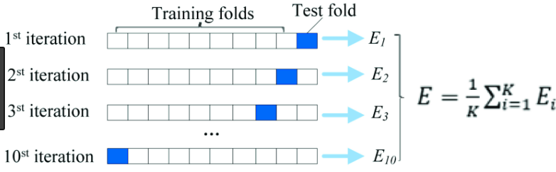
k-Fold Cross-Validation

Slide 18
k-Fold Cross-Validation with Validation and Test Set
A slightly less granular approach is to use a single k-fold cross validation with both a validation and test set.
  The total data set is split in k sets.
  One by one, a set is selected as test set.
  Then, one by one, one of the remaining sets is used as a validation sets.
  The other k-2 sets are used as training sets until all possible combinations have been evaluated.

Slide 19
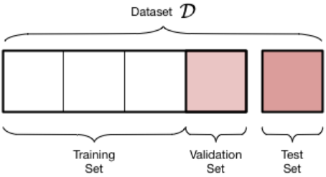
k-Fold Cross-Validation with Validation and Test Set
A slightly less granular approach is to use a single k-fold cross validation with both a validation and test set.

Slide 20
More on Cross-Validation
Standard method for evaluation: stratified 10-fold cross-validation.
Why 10? Extensive experiments have shown that this is the best choice to get an accurate estimate.
Stratification reduces the estimate’s variance.
Even better: repeated stratified cross-validation:
  E.g. ten-fold cross-validation is repeated ten times and results are averaged (reduces the variance).

Slide 21
Leave-One-Out Cross-Validation
Leave-One-Out is a particular form of cross-validation:
  Set number of folds to number of training instances;
  I.e., for n training instances, build classifier n times.
Makes best use of the data.
Involves no random sub-sampling.
Very computationally expensive.

Slide 22
Leave-One-Out Cross-Validation and Stratification
A disadvantage of Leave-One-Out-CV is that stratification is not possible:
  It guarantees a non-stratified sample because there is only one instance in the test set!
Extreme example - random dataset split equally into two classes:
  Best inducer predicts majority class;
  50% accuracy on fresh data;
  Leave-One-Out-CV estimate is 100% error!

Slide 23
Bootstrap Method (自助法)
Cross validation uses sampling without replacement:
  The same instance, once selected, can not be selected again for a particular training/test set
The bootstrap uses sampling with replacement to form the training set:
  Sample a dataset of n instances n times with replacement to form a new dataset of n instances;
  Use this data as the training set;
  Use the instances from the original dataset that don’t occur in the new training set for testing.

Slide 24
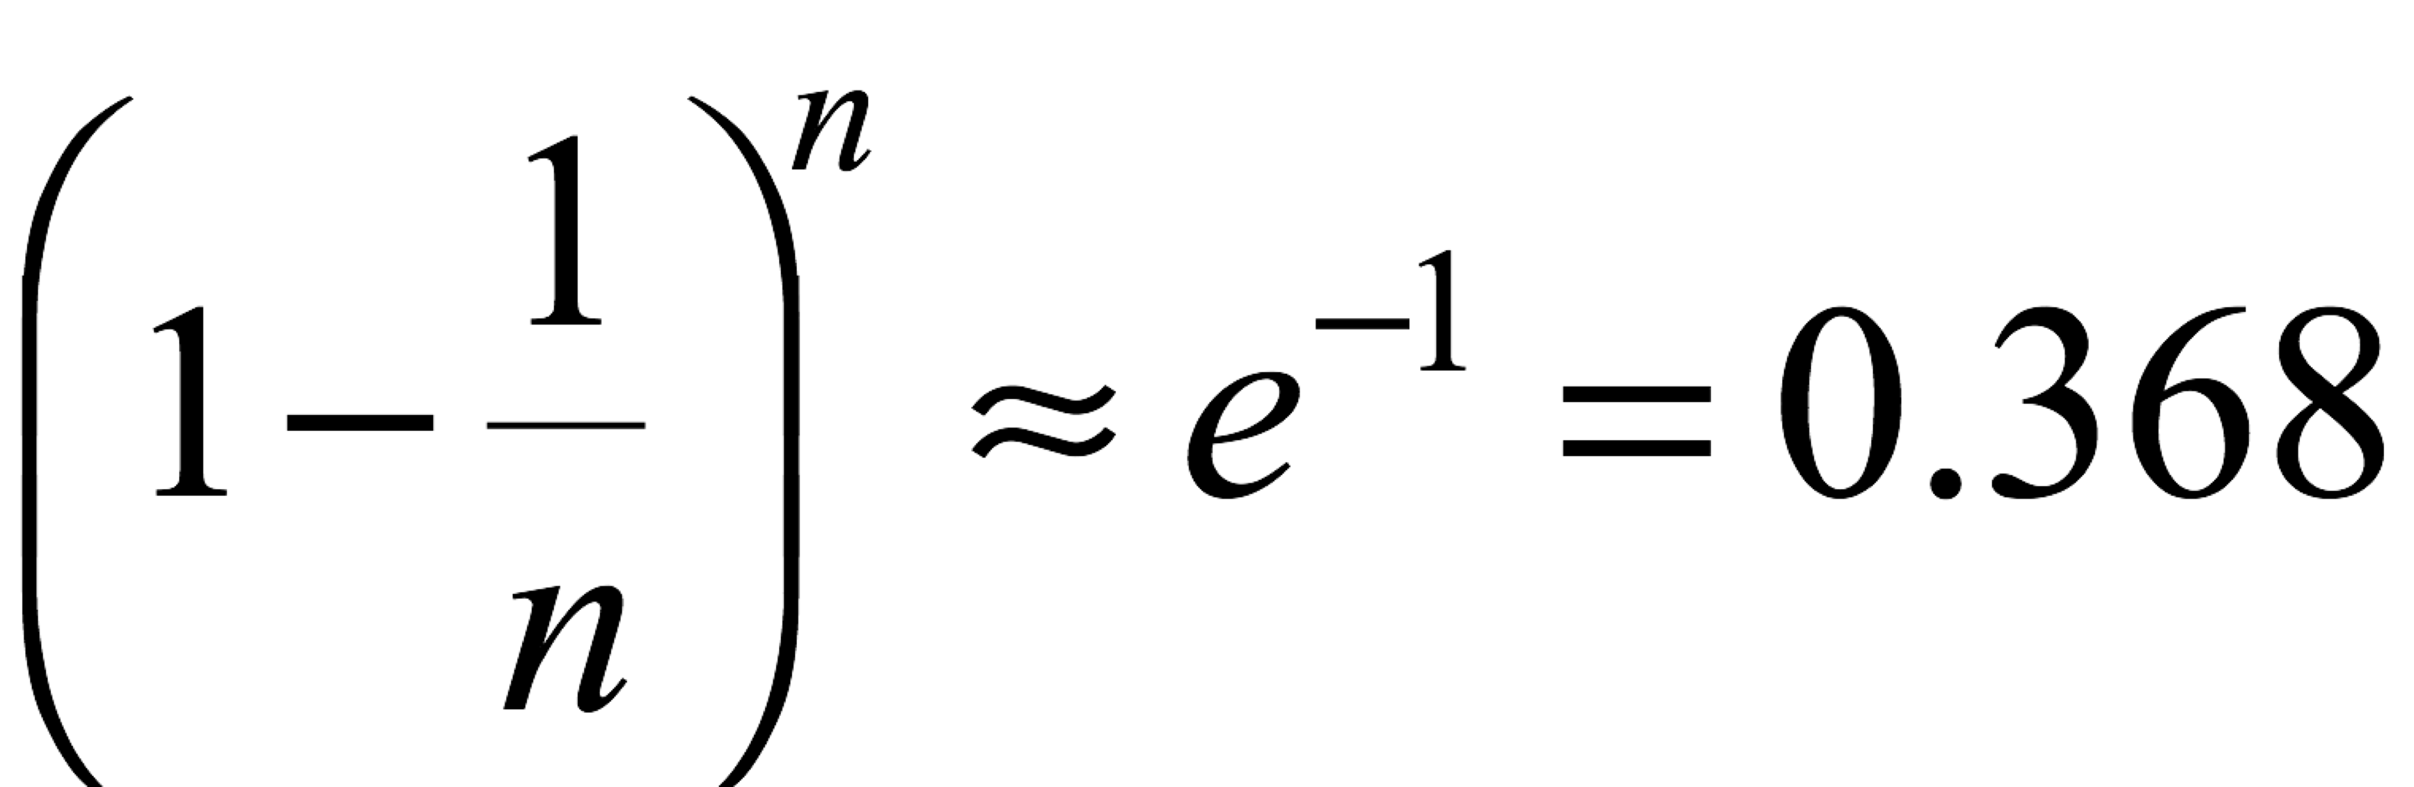
Bootstrap Method
The bootstrap method is also called the 0.632 bootstrap:
  A particular instance has a probability of 1–1/n of not being picked;
  Thus its probability of ending up in the test data is:
  This means the training data will contain approximately 63.2% of the instances and the test data will contain approximately 36.8% of the instances.

Slide 25
Estimating Error with the Bootstrap Method
The error estimate on the test data will be very pessimistic because the classifier is trained on just ~63% of the instances.
Therefore, combine it with the training error:
The training error gets less weight than the error on the test data.
Repeat process several times with different replacement samples; average the results.

Slide 26
Metric Evaluation Summary:
Use test sets and the hold-out method for “large” data;
Use the cross-validation method for “middle-sized” data;
Use the leave-one-out and bootstrap methods for small data;
Don’t use test data for parameter tuning - use separate validation data.

Slide 27
Thank You!

